Slide 1
Figures – Chapter 5

Slide 2
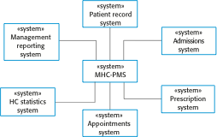
Figure 5.1 The context of the MHC-PMS

Slide 3
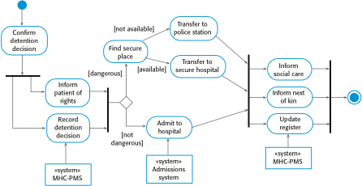
Figure 5.2 Process model of involuntary detention

Slide 4

Figure 5.3 Transfer-data use case

Slide 5
Figure 5.4 Tabular description of the ‘Transfer data’ use-case
MHC-PMS: Transfer data
Actors | Medical receptionist, patient records system (PRS)
Description | A receptionist may transfer data from the MHC-PMS to a general patient record database that is maintained by a health authority. The information transferred may either be updated personal information (address, phone number, etc.) or a summary of the patient’s diagnosis and treatment.
Data | Patient’s personal information, treatment summary
Stimulus | User command issued by medical receptionist
Response | Confirmation that PRS has been updated
Comments | The receptionist must have appropriate security permissions to access the patient information and the PRS.

Slide 6
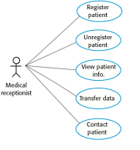
Figure 5.5 Use cases involving the role ‘Medical Receptionist’

Slide 7
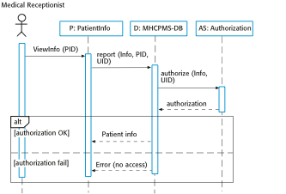
Figure 5.6 Sequence diagram for View patient information

Slide 8
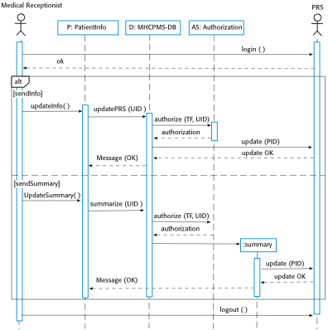
Figure 5.7 Sequence diagram for Transfer Data

Slide 9
Figure 5.8 UML classes and association

Slide 10
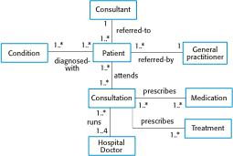
Figure 5.9 Classes and associations in the MHC-PMS

Slide 11

Figure 5.10 The Consultation class

Slide 12
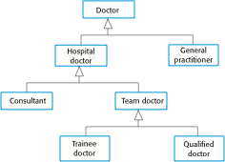
Figure 5.11 A generalization hierarchy

Slide 13
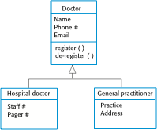
Figure 5.12 A generalization hierarchy with added detail

Slide 14

Figure 5.13 The aggregation association

Slide 15
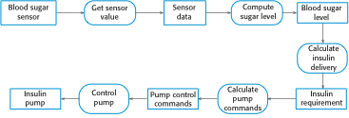
Figure 5.14 An activity model of the insulin pump’s operation

Slide 16
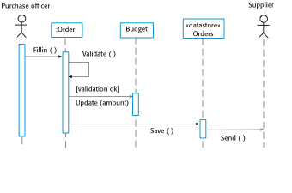
Figure 5.15 Order processing

Slide 17
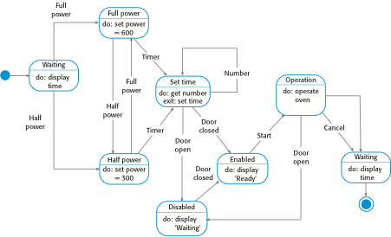
Figure 5.16 State diagram of a microwave oven

Slide 18
Figure 5.17 States and stimuli for the microwave oven (a)
State | Description
Waiting | The oven is waiting for input. The display shows the current time.
Half power | The oven power is set to 300 watts. The display shows ‘Half power’.
Full power | The oven power is set to 600 watts. The display shows ‘Full power’.
Set time | The cooking time is set to the user’s input value. The display shows the cooking time selected and is updated as the time is set.
Disabled | Oven operation is disabled for safety. Interior oven light is on. Display shows ‘Not ready’.
Enabled | Oven operation is enabled. Interior oven light is off. Display shows ‘Ready to cook’.
Operation | Oven in operation. Interior oven light is on. Display shows the timer countdown. On completion of cooking, the buzzer is sounded for five seconds. Oven light is on. Display shows ‘Cooking complete’ while buzzer is sounding.

Slide 19
Figure 5.17 States and stimuli for the microwave oven (b)
Stimulus | Description
Half power | The user has pressed the half-power button.
Full power | The user has pressed the full-power button.
Timer | The user has pressed one of the timer buttons.
Number | The user has pressed a numeric key.
Door open | The oven door switch is not closed.
Door closed | The oven door switch is closed.
Start | The user has pressed the Start button.
Cancel | The user has pressed the Cancel button.

Slide 20
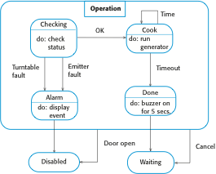
Figure 5.18 Microwave oven operation

Slide 21
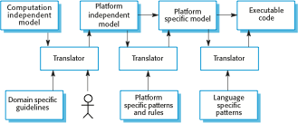
Figure 5.19 MDA transformations

Slide 22
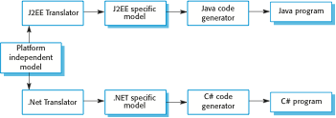
Figure 5.20 Multiple platform-specific models

